Slide 1
Sleep Apnea Detection Model
Debug Divas

Slide 2
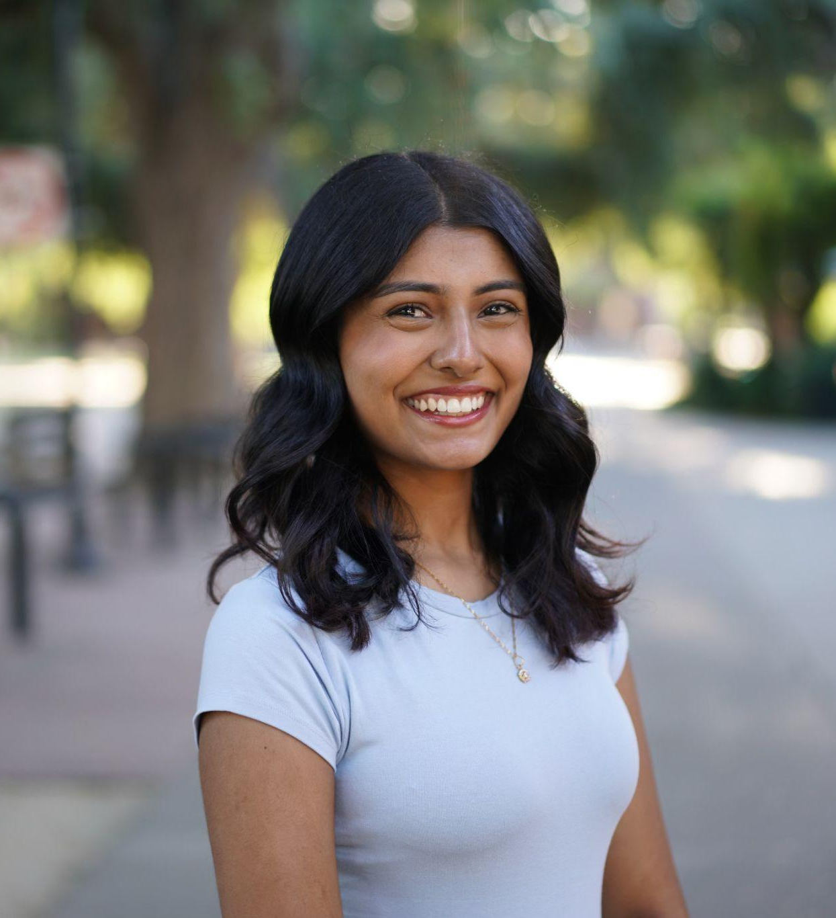
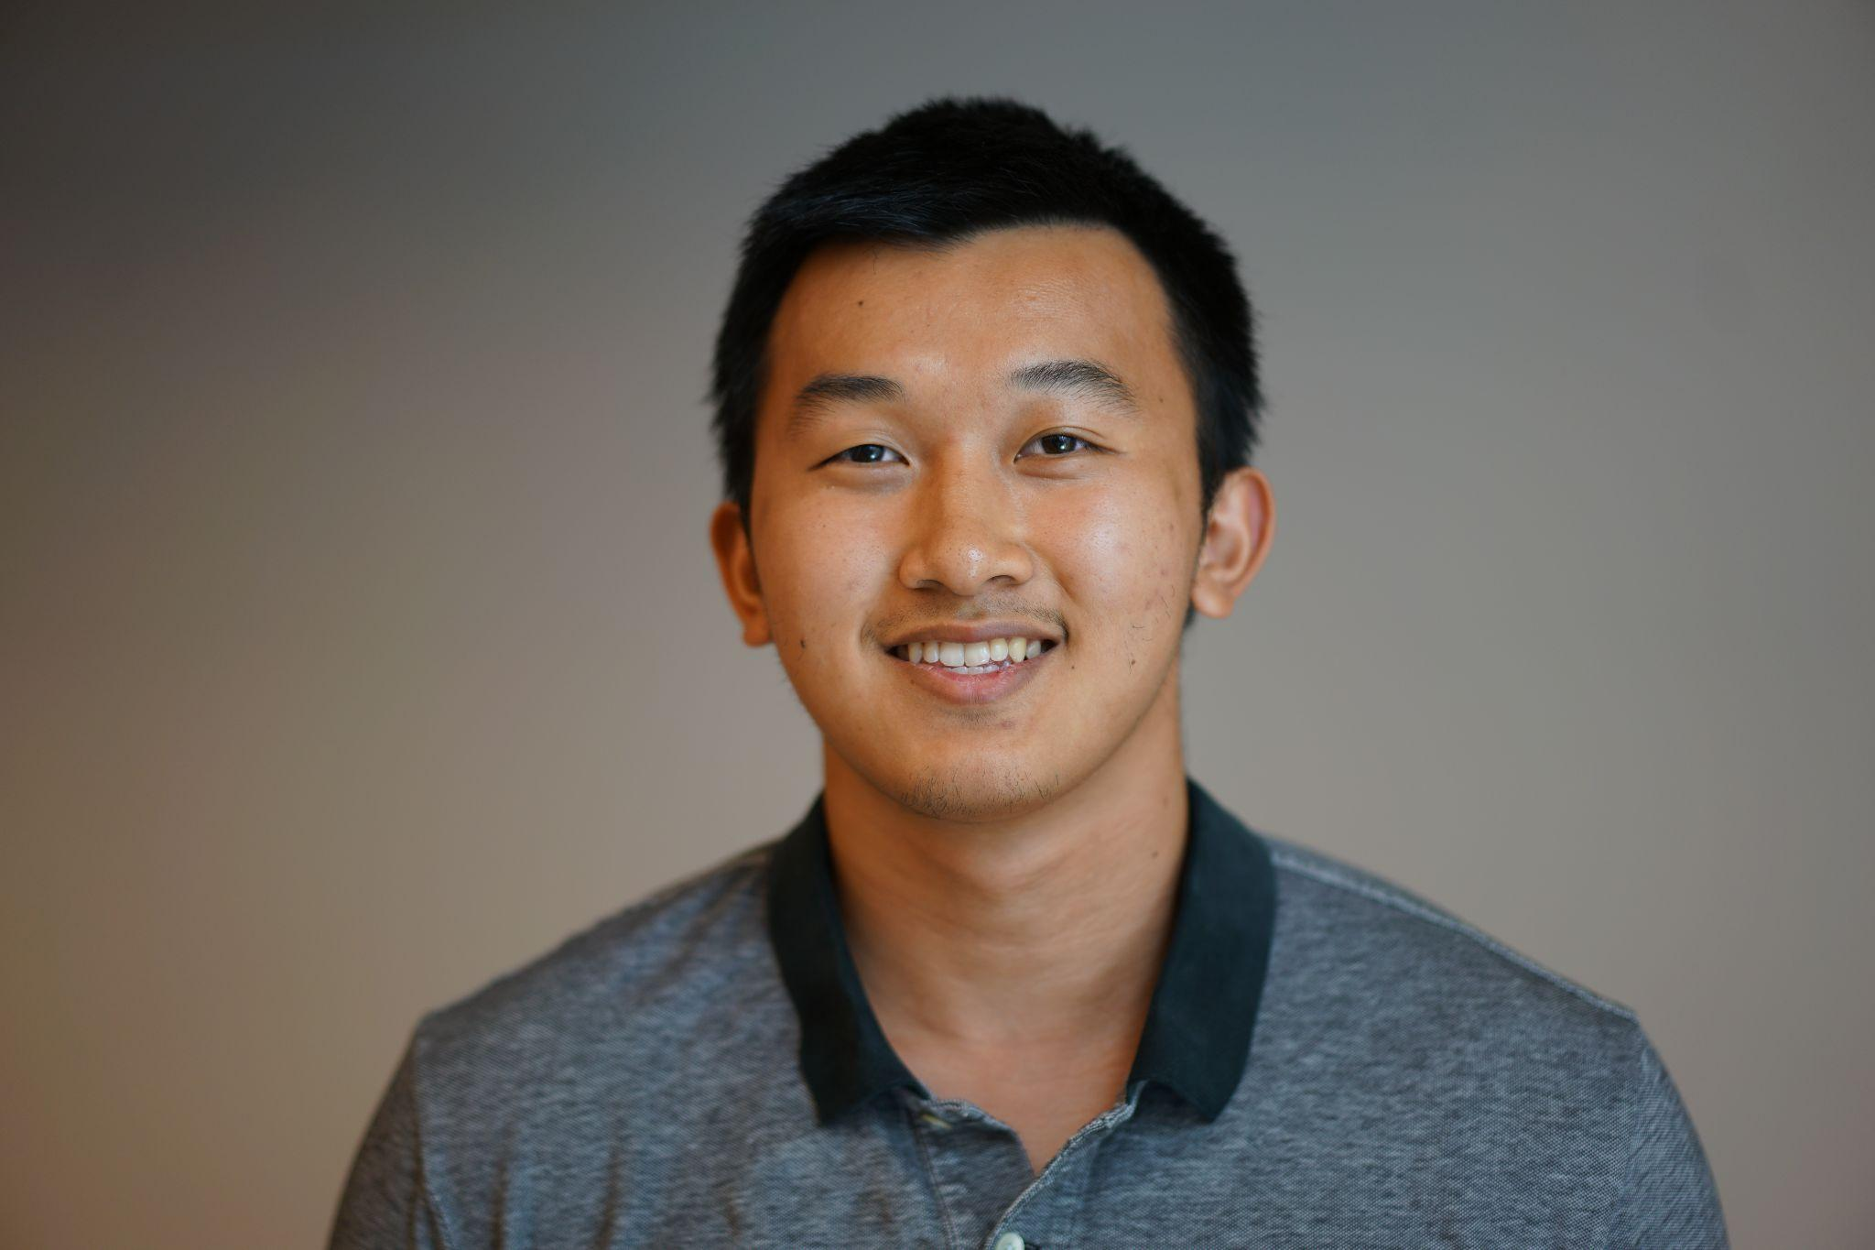
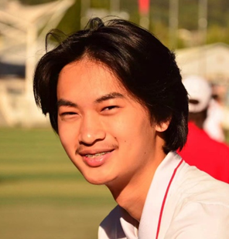
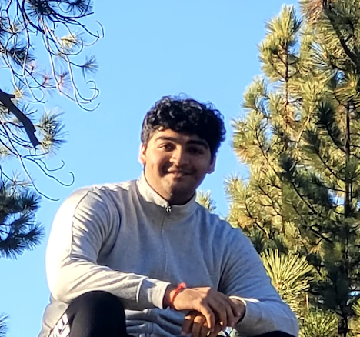
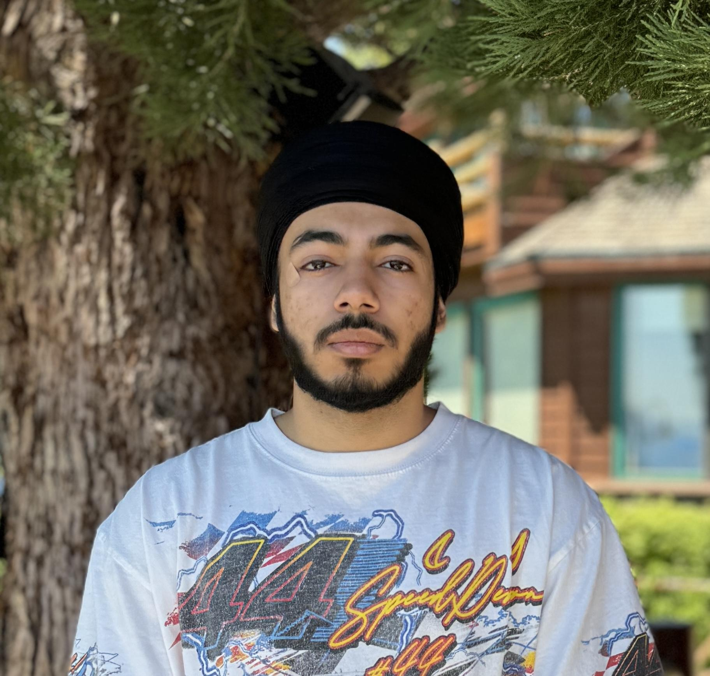
Meet the Team
Pranavi Khanna
Computer Science
Fun Fact: I have fostered 3 dogs!
James Wei
Data Science
Fun Fact:
I have crashed my bike twice already
Qiyuan Tan
Computer Science and Engineering
Fun Fact: Have the longest major name in the group
Pritul Vachhani
Comp Science
Fun Fact:
I always double-check if I locked the door… three times.
Gurkirat Singh
Data Science
Fun Fact: I have a pet rabbit

Slide 3
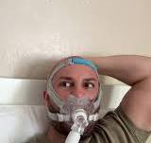
Sleep apnea is like bad wifi:- just when you get comfortable it cuts out!

Slide 4
Why Sleep Apnea Model Important
30 Million Americans have sleep apnea, but only 20% are actually diagnosed
Sleep studies costs ~$1,000-3,000 and take a whole night to perform
Key statistics:
Over 936 million people worldwide suffer from sleep apnea.
Health risks: Links to heart disease, stroke, and daytime fatigue.
Economic impact: Workplace productivity loss and healthcare costs.
A short testimonial: "I didn’t realize how bad my sleep was until I got tested!"

Slide 5
Procedure

Slide 6
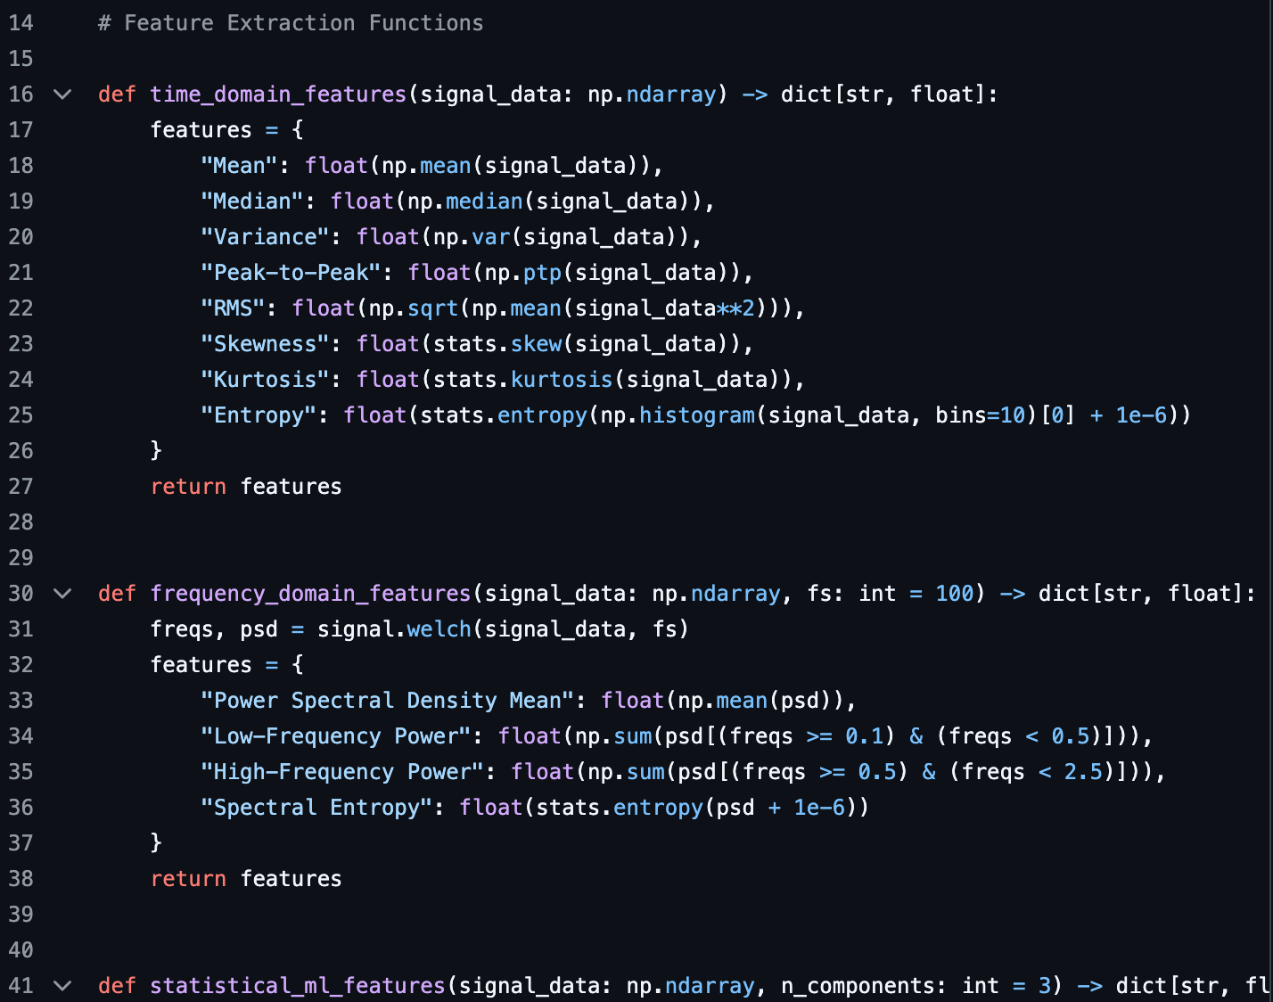
Data Collection and Preprocessing
Used Kaggle ECG dataset (2,500 ECG features + Target column).
Converted "Target" to binary labels (0 = Normal, 1 = Sleep Apnea).
Dropped missing values and prepared the data for training.
Extracted time domain and frequency domain features from raw ECG data

Slide 7
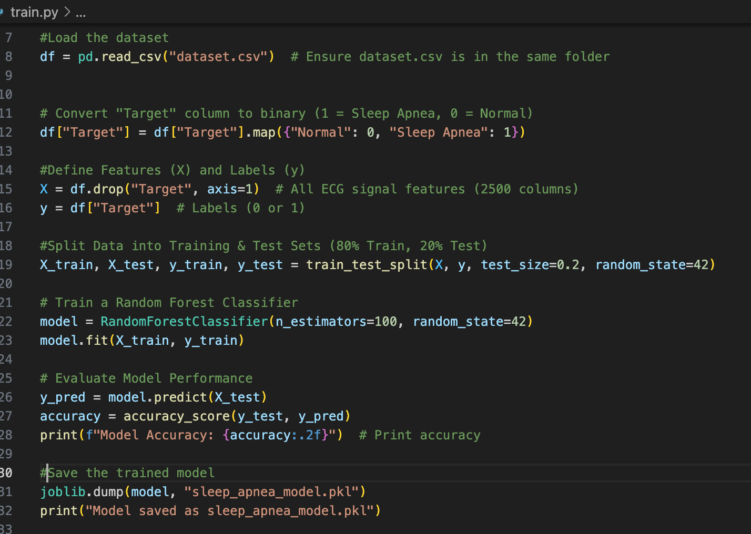
Model training and deploying
Trained Random Forest Classifier with 80% training, 20% testing split.
Achieved 97.56% accuracy in sleep apnea classification.
Created an interactive UI for users to enter ECG data.
Model predicts a risk score (0-100%) based on input.
Categorized risk into Low (0-30%), Moderate (30-70%), High (70-100%).

Slide 8
Vocabulary Learnt
AHI (Apnea-Hypopnea Index) – Measures sleep apnea severity
Polysomnography – Sleep study used to diagnose sleep apnea.
ECG (electrocardiogram) Test - Records the electrical signals from the heart

Slide 9
Essential Libraries
Scikit-Learn
Machine Learning Toolbox
Pandas
Data Arrangement
Numpy
Data Manipulation
Streamlit
Web App Framework

Slide 10
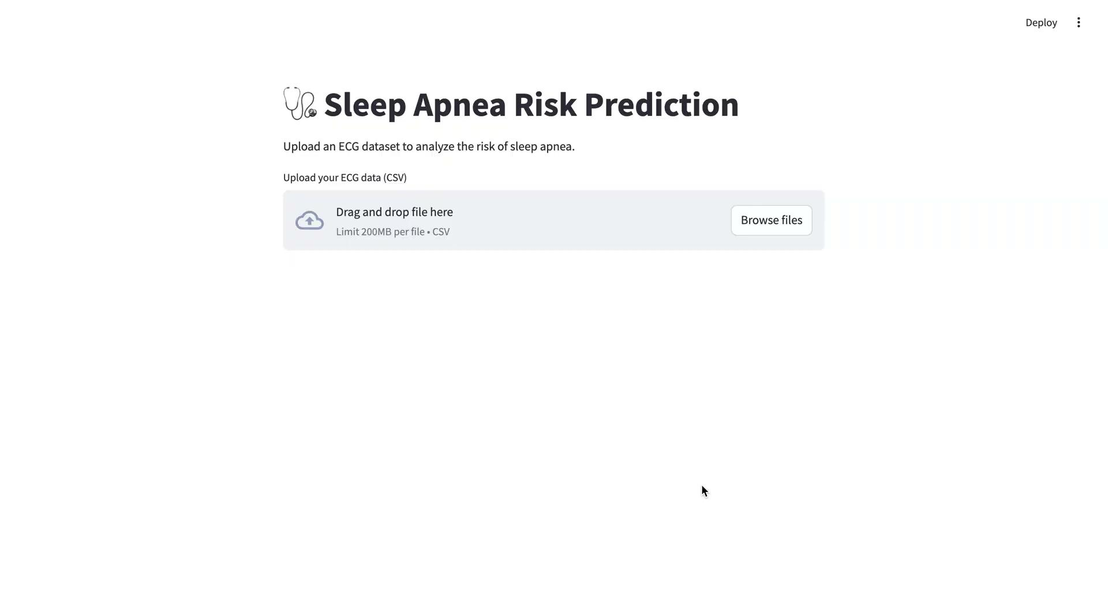
Demo

